Slide 1



Evaluating Revegetation Techniques for Enhanced Disposal Cell Covers
Jasmine Engel, Intern MES Pre-College University
U.S. Department of Energy (DOE) Office of Legacy Management (LM)

Slide 2
Project Introduction
Legacy Management History
Manages post-closure responsibilities at remediated sites, ensuring long-term protection
Enhanced Cover Application Project (ECAP)
Goal: Improve the hydrological performance and sustainability of disposal cell covers
Evapotranspiration
Plants aid in keeping pore water from percolation deep into the ground
Goal: Minimize percolation of precipitation through disposal cell covers using a cover enhancement approach.

Slide 3
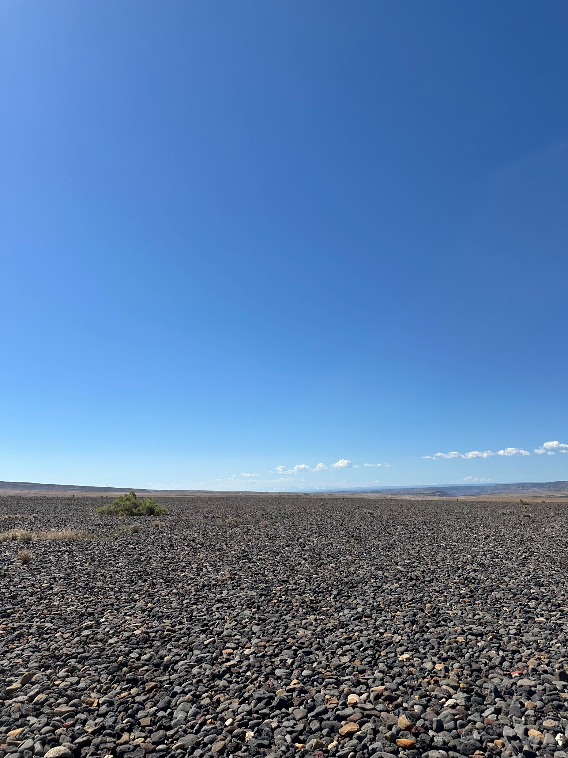
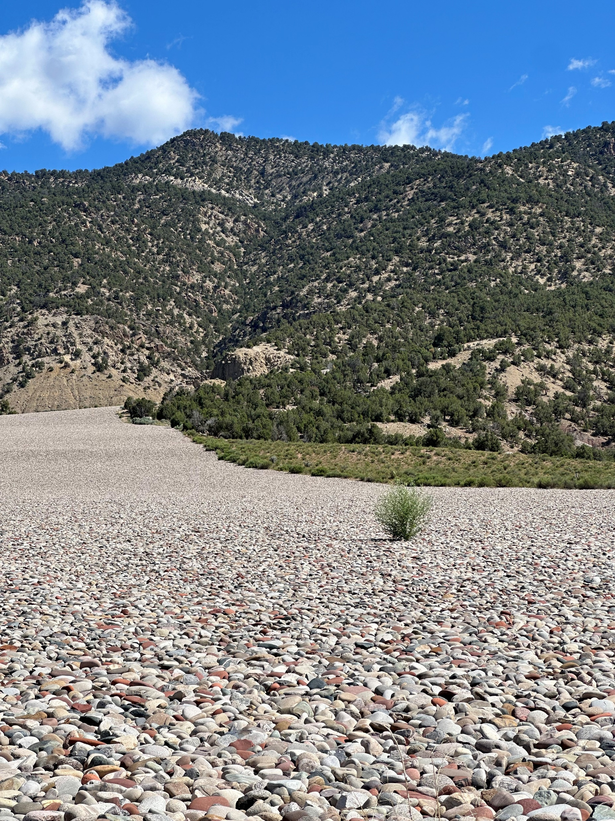
Location Background
Grand Junction Disposal Site (GJDS)
Test site since 2008, proven success with three cover enhancement tests
Rifle Disposal Site
Higher elevation
Capped in 1996
Facing excessive water infiltration
Immediate remedy = pump and evaporate
Long-term remedy = cover enhancements
GJDS
Rifle
Notes:
ESD- a land description to help determine land management WITH information like soil type and plant species
The test pads were constructed with stockpile materials in 2007 -- BUT they contained no contamination
The pilot test started in 2020 and is on the in-service disposal cell
Three test plots (natural succession, enhanced revegetation, and a control), each 2.5 acres
*Include Emily picture

Slide 4
Revegetation Techniques
1. Adaptive vegetation management
2. Hydroseeding
3. Species selection
4. Broadcast seeding
5. Transplanting
6. Monitoring

Slide 5
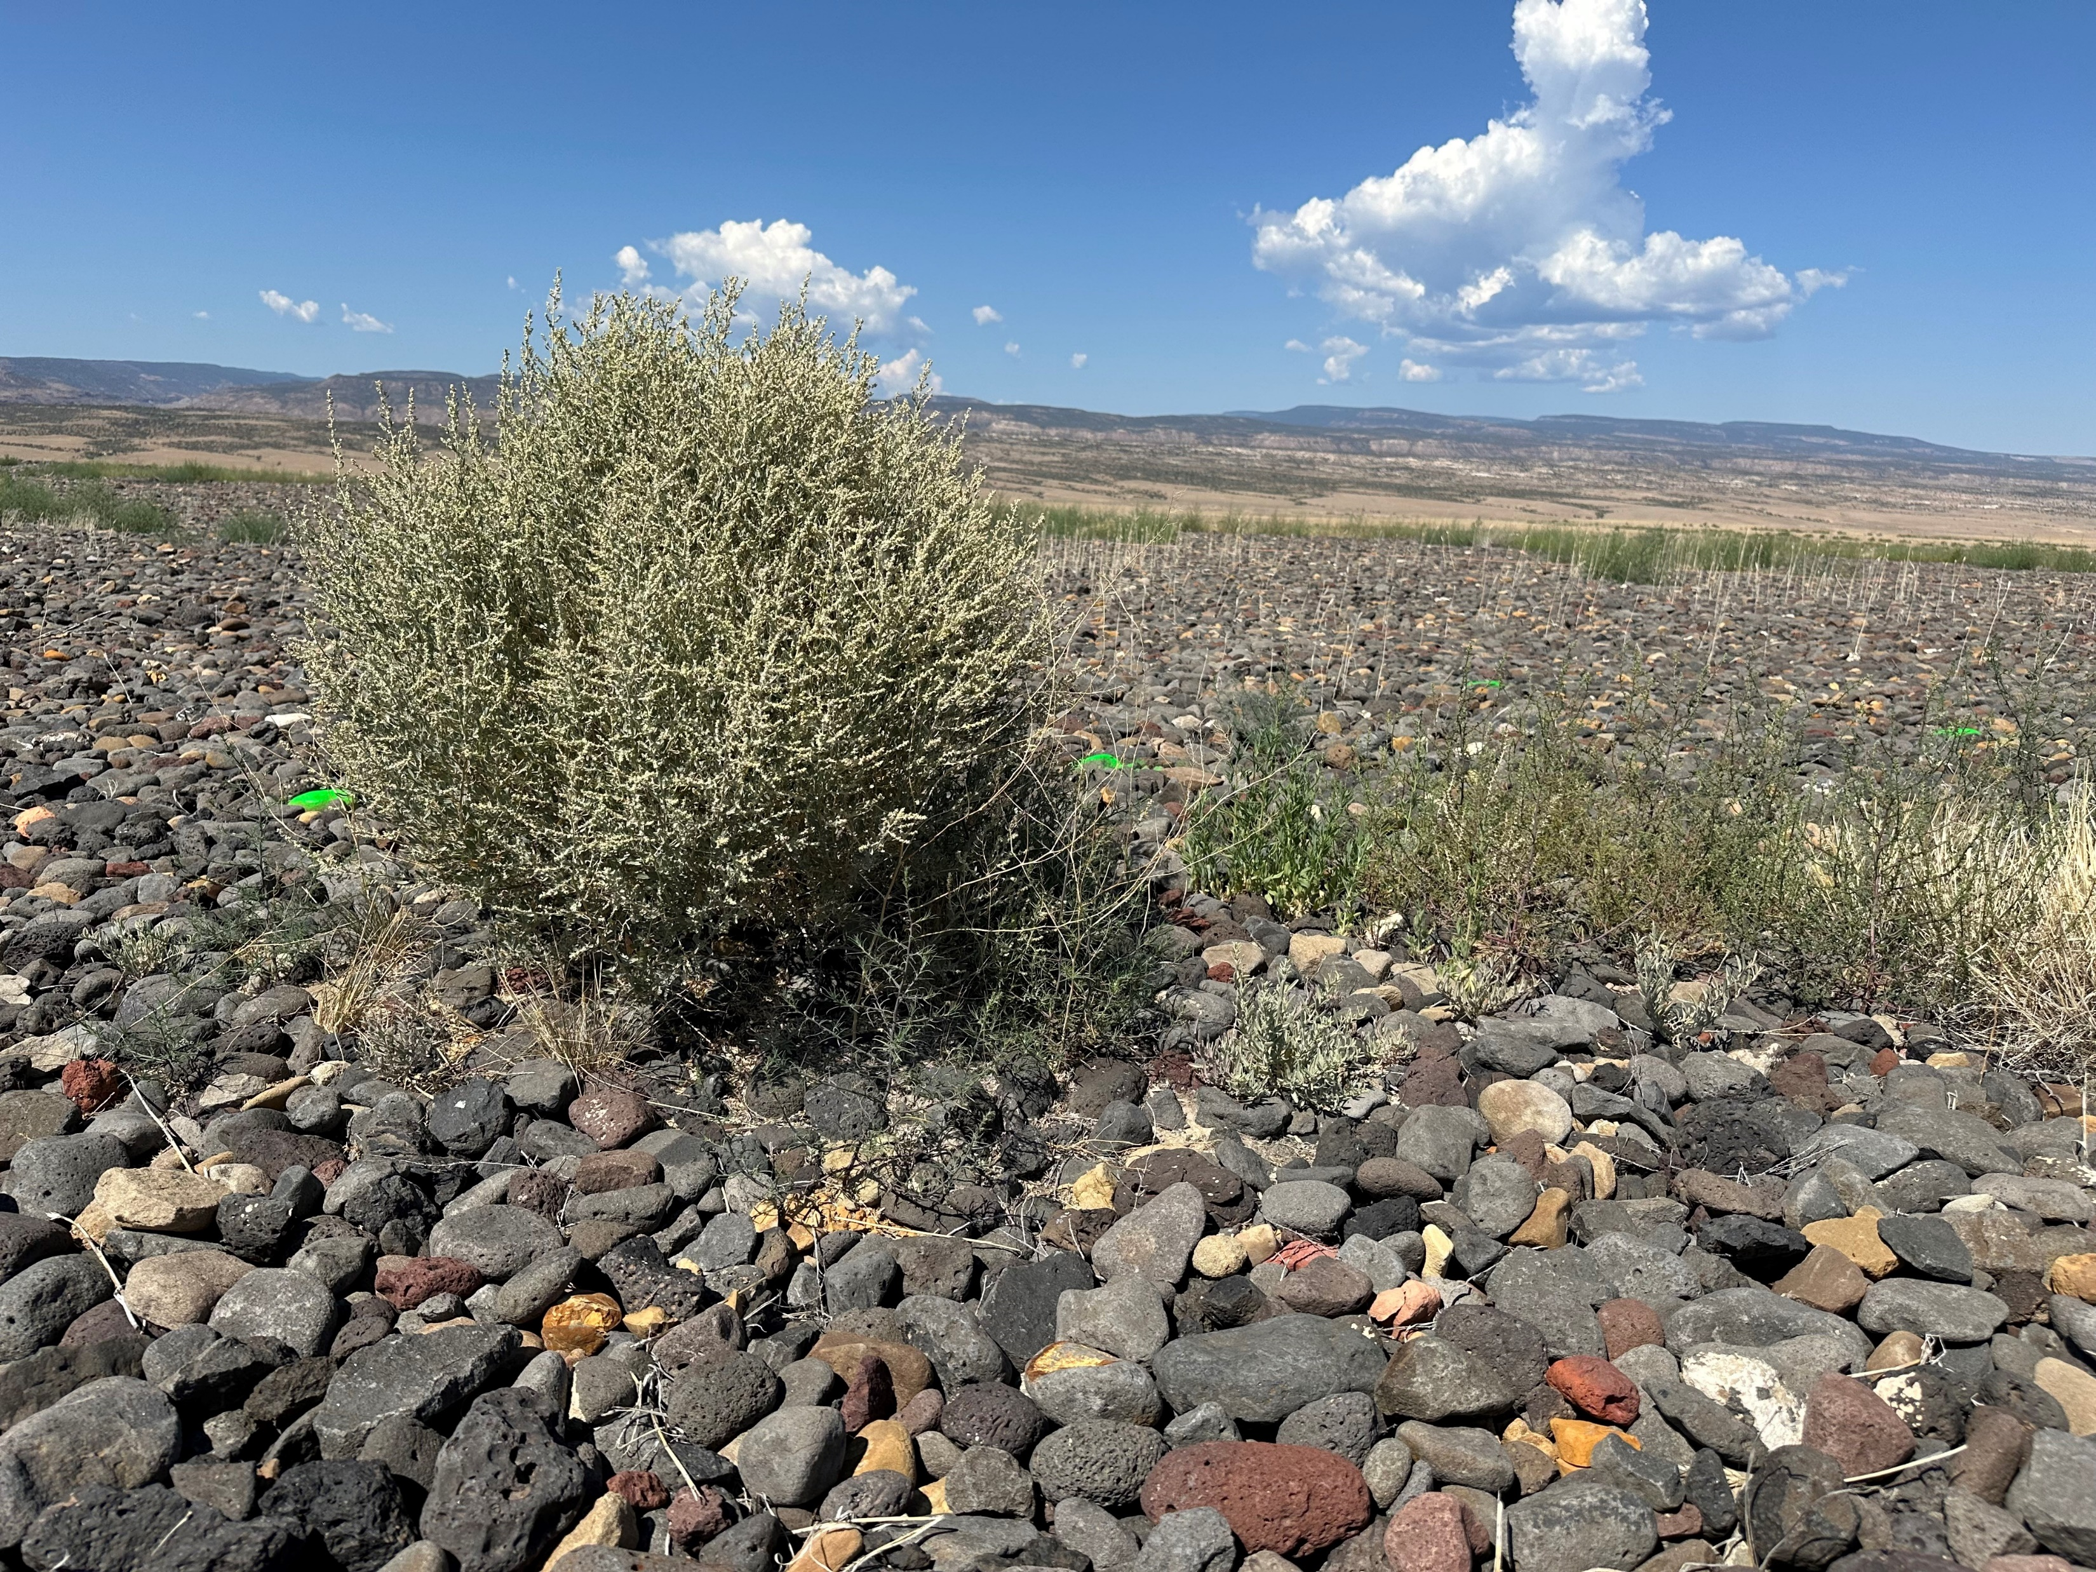
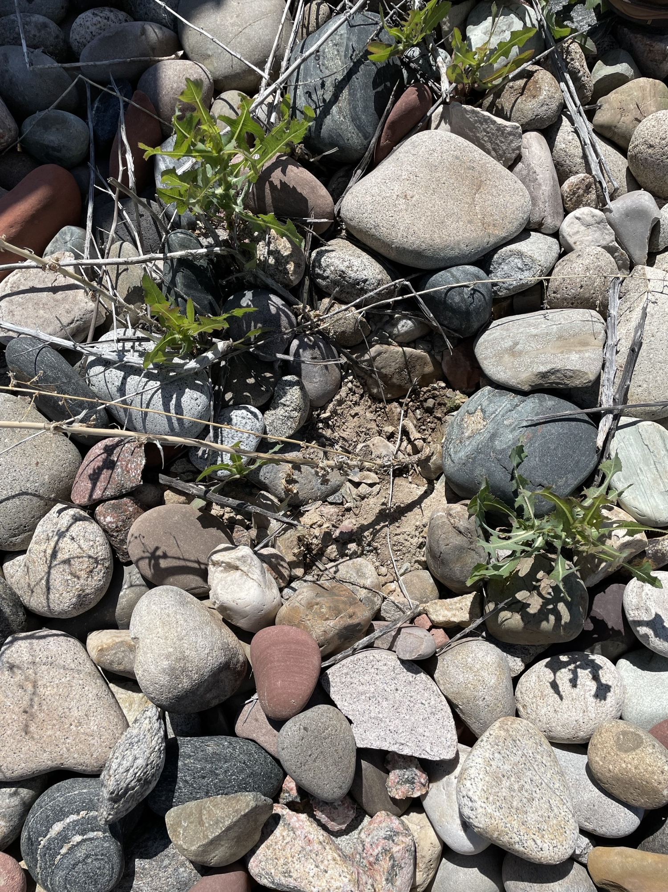
1. Adaptive Vegetation Management
Fourwing Saltbush — one plant produced about 10 new plants, adding organic material and seeds
GJDS
GJDS test pad showed 10-12% vegetation cover within 6 years = 93% reduction in percolation
Slow initial growth
Rifle
Benefits
Proven success at GJDS
Cost effective and sustainable
Challenges
Large void space in riprap may limit plant establishment
Slower process due to limited natural soil accumulation
5
Natural soil accumulation
Notes:
Fourwing Saltbush- ATCA

Slide 6
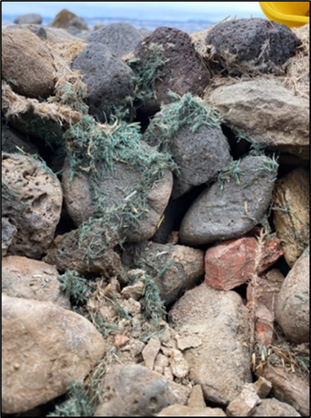
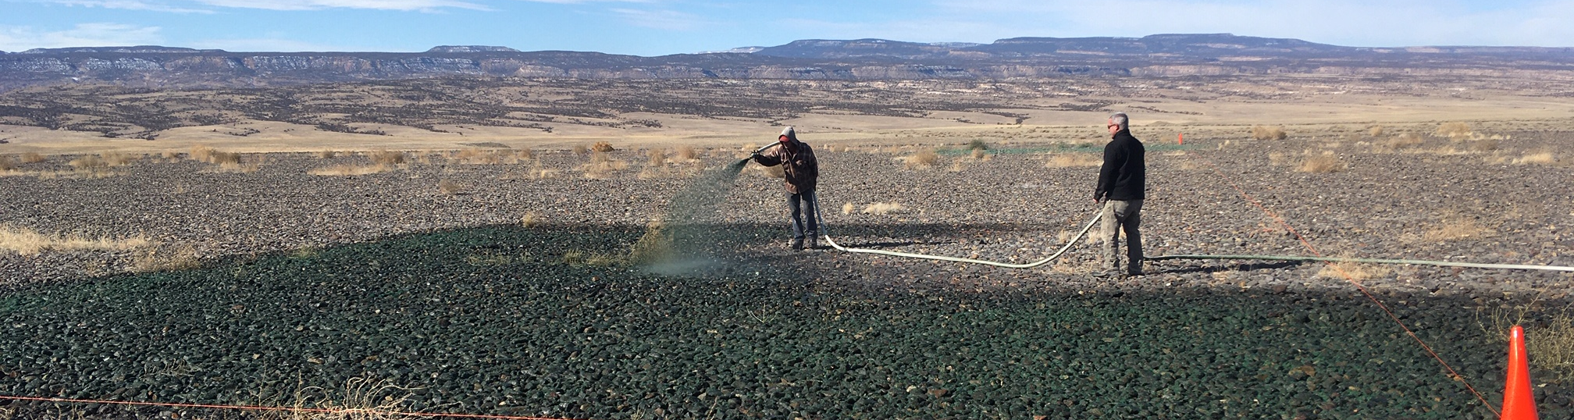
2. Hydroseeding
GJDS
Easy to apply
Low revegetation success rate
One plant over ~ half acre test area
Rifle
Benefits
Easy application
Potential success on the rounded riprap
Challenges
Poor results in arid environments
Expensive
Notes:
ACHY- a great species that will be continued to be seeded
Hydroseeding helped show this
Tackifier- adhesive for material to stay down to establish & for erosion reason

Slide 7
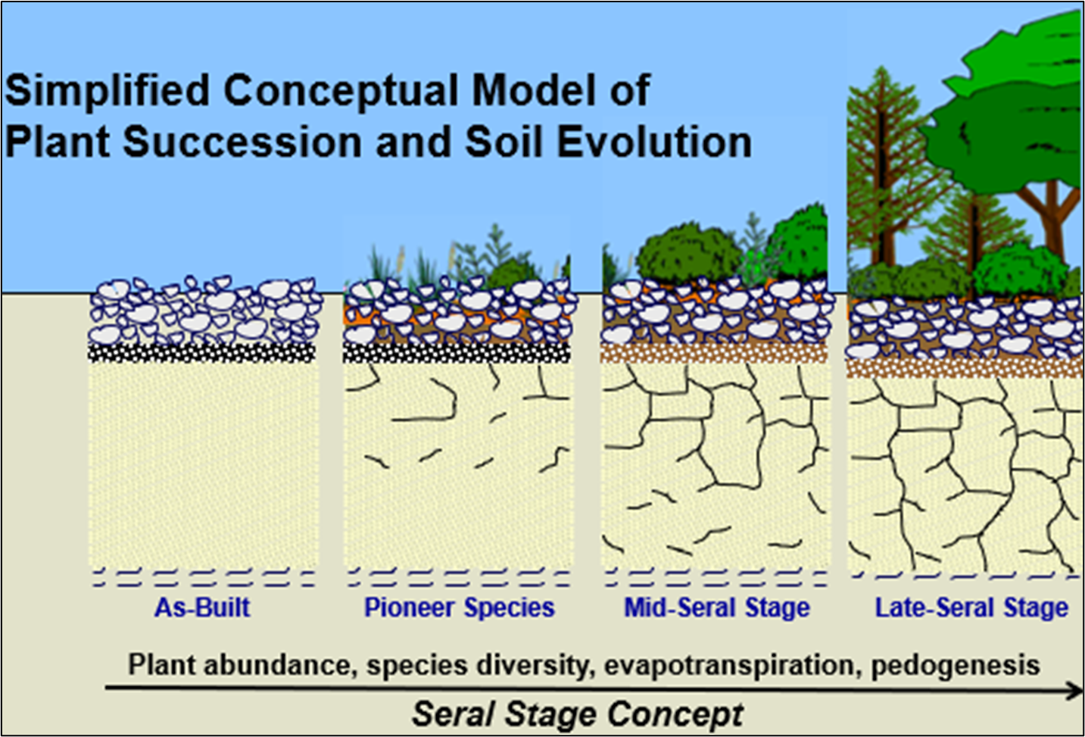
3. Species Selection
GJDS
Cover crop
Early/mid successional species
Mid/late successional species
Rifle
Benefits
Natural climate and ecology supports long-lived plant communities
GJDS data show plant community matures over time
Challenges
Limited aeolian deposition and natural succession
Past vegetation management
Species selected for revegetation techniques are designed to mimic and speed up natural succession

Slide 8
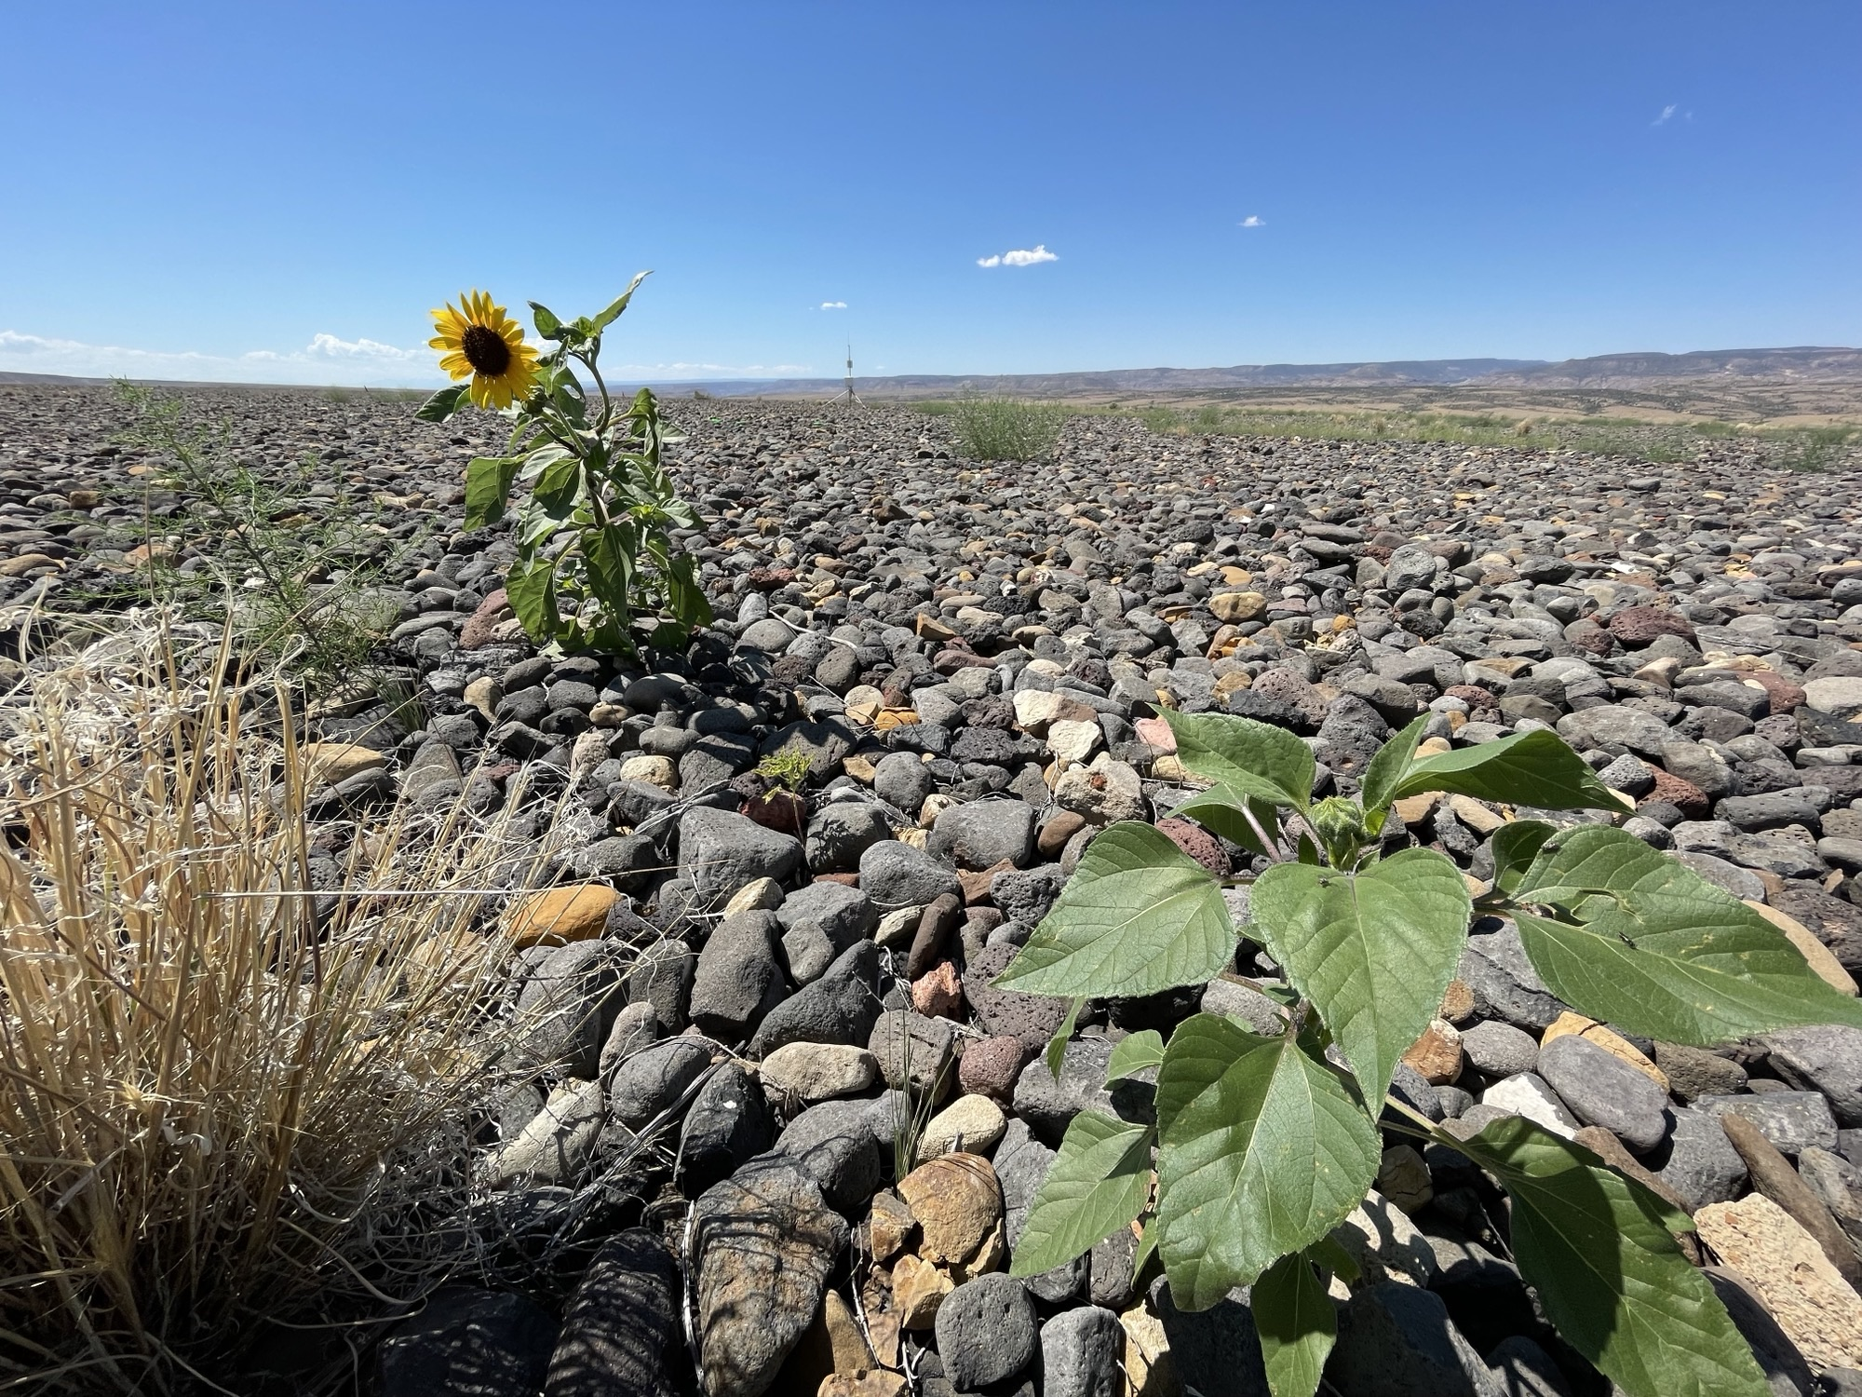
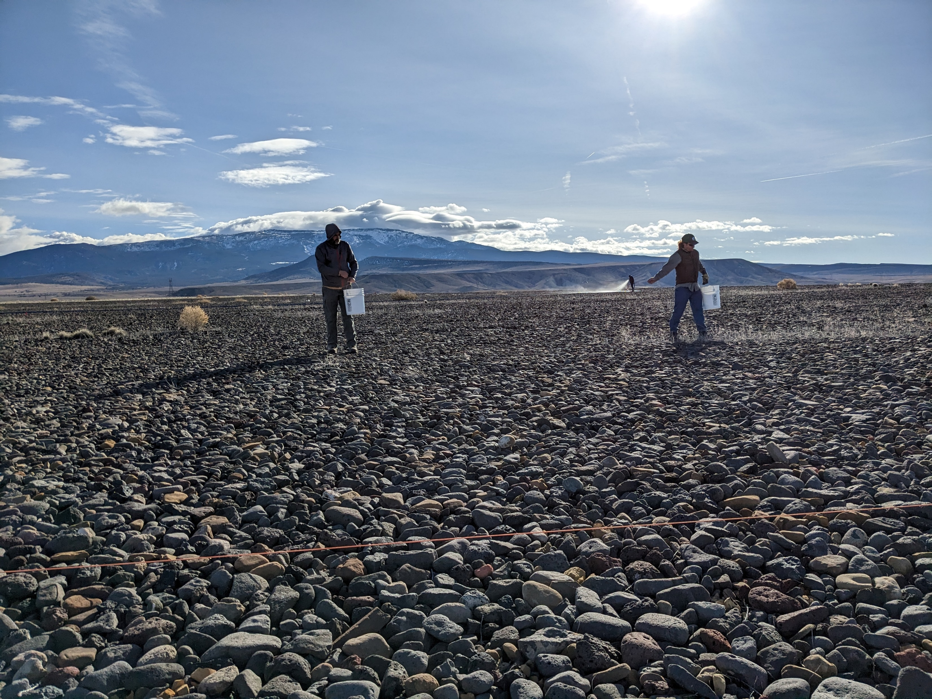
4. Broadcast Seeding
GJDS
Cost-effective
10 species germinated — 1.5% increase in total foliar cover
Slower establishment over multiple seasons
Rifle
Benefits
Better success on rounded riprap — anticipated to establish long-term plant community
Challenges
Labor intensive and moderately expensive
8
Notes:
Subsequent refined -- Taking note of what worked and didn’t work for future reference

Slide 9
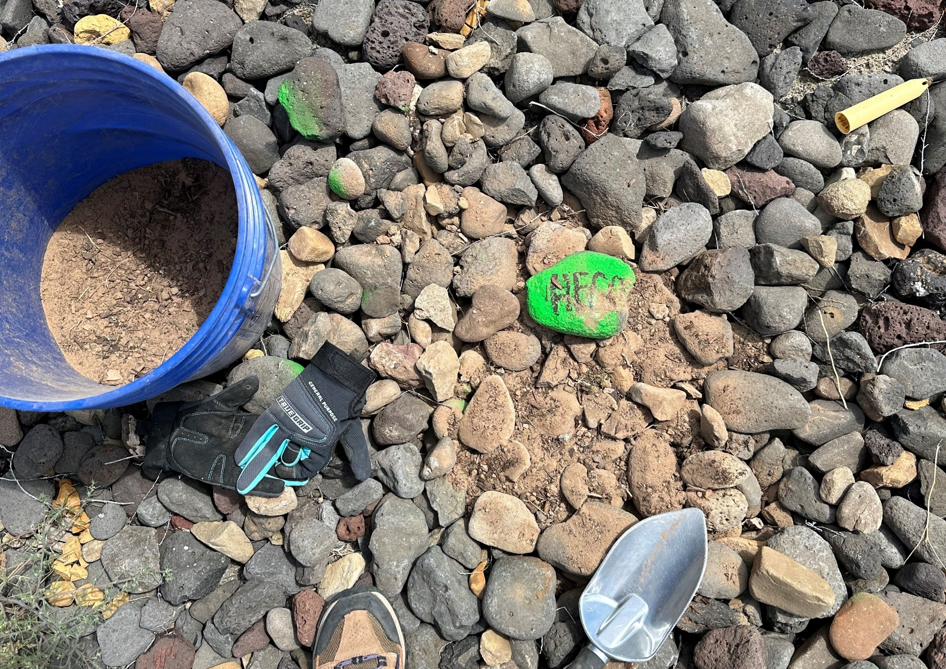
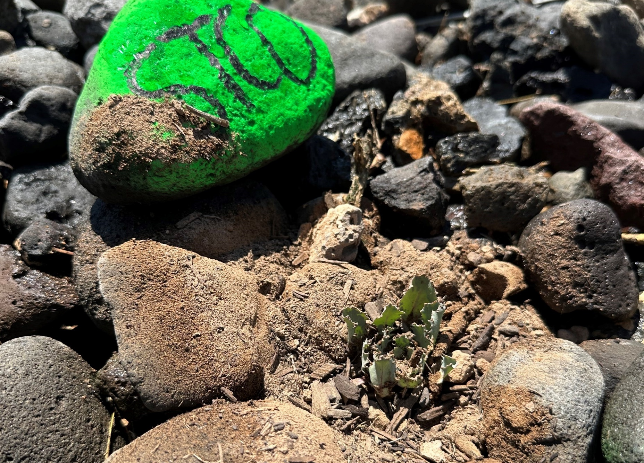
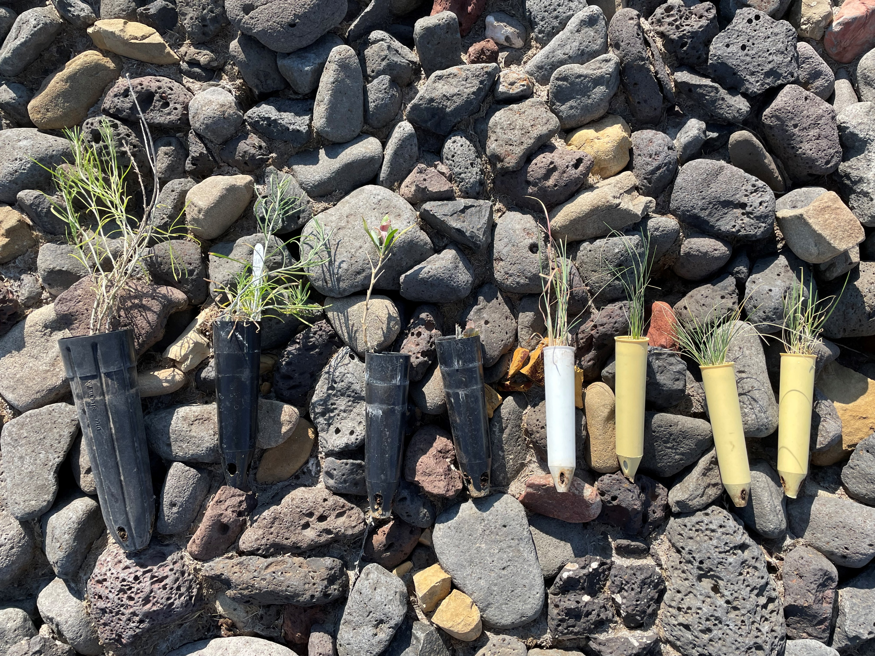
5. Transplanting
GJDS
High success rate (64%)
Quicker establishment
Rifle
Benefits
Speeds up plant community establishment
Challenges
Labor intensive
Moderately cost effective
Notes:
Findings support future plants planted

Slide 10
Comparing Costs
1. Hydro seeding*
$7,000 / acre
2. Broadcast seeding*
$1,100 / acre
3. Transplanting*
$3,300 / acre
4. Pore water extraction at Rifle
Multimillion dollar project + annual maintenance
*Implemented as test studies — more expensive than full-scale application
Notes:
1. Hydro seeding*
$8,450 for only 6000 sqft
For just one day
A trial test of 3 different mixtures
2. Broadcast seeding*
$2,836.07 for the whole 2.5-acre plot
Mix of seeds used in Spring 2023 & 2024
3. Transplanting*
$8,200 for 500 plants
Installed through the dates of August 2023, July 2024, and September 2024
4. Pore water extraction @Rifle
Includes pumping and evaporating

Slide 11
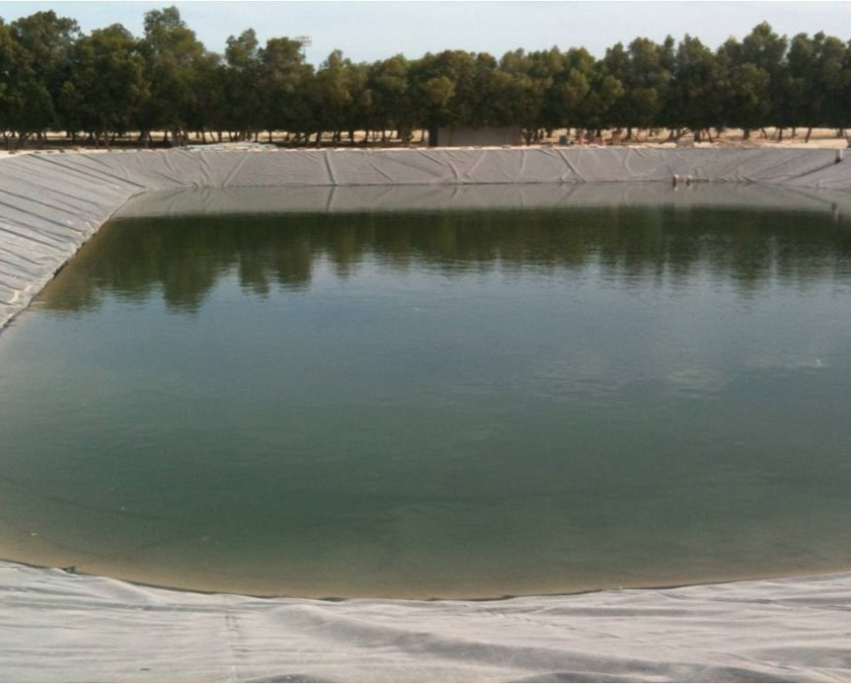
Pore Water Management at Rifle
Pump and Evaporation System
Benefits
100% critical to provide immediate results and fulfill LM mission
Immediate results
Challenges
Costly
Complex infrastructure
Short operational life span (20-30 years)
Maintenance
Does not address source
Cover Enhancements
Benefits
Long-term performance
Cost effective
Addresses the source
Passive/nature-based solution
Supporting data
Challenges
Results are not immediate
Current conditions (riprap/no vegetation)
Pilot test before full scale application

Slide 12
THANK YOU!
Any questions or comments?
jasmineengel970@gmail.com | jasmine1.engel@famu.edu

